Slide 1
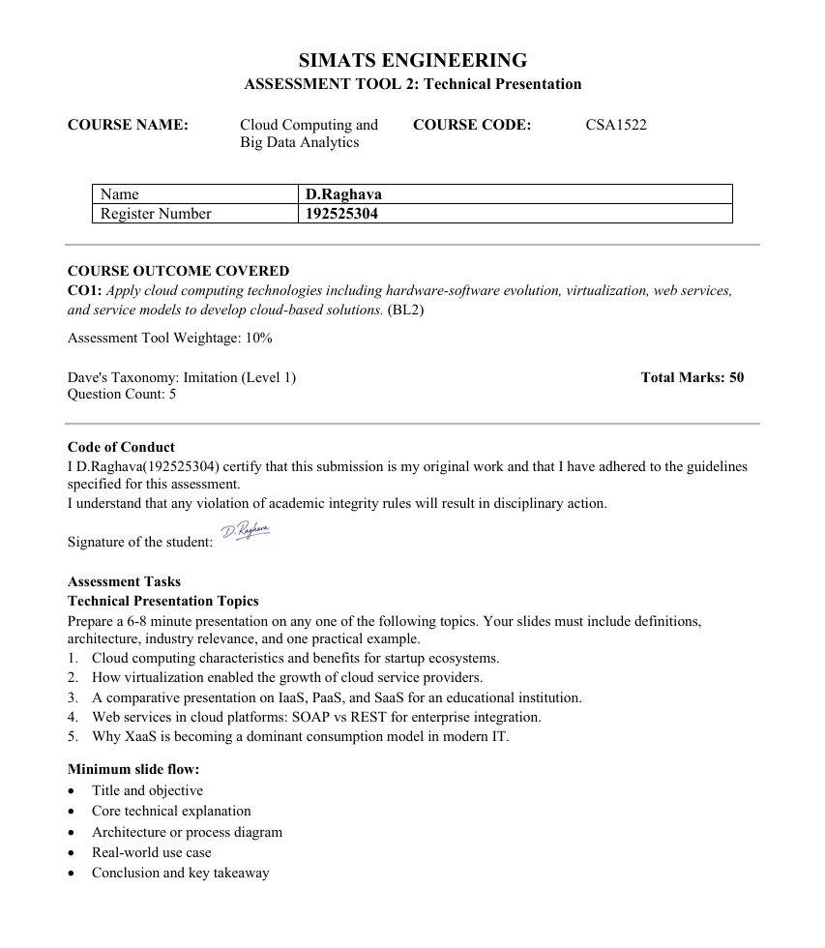

Slide 2
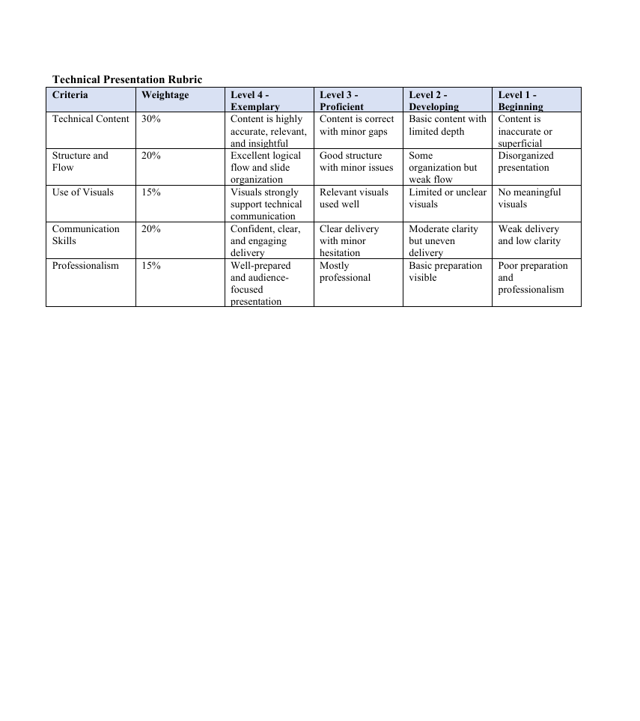

Slide 3


Cloud computing characteristics and benefits for startup ecosystems.
By:
P.guru(192521010)
S.Bala(192524427)
D.Raghava(192525304)

Slide 4


Objective
To understand the concept of cloud computing.
To learn the major characteristics of cloud computing.
To explore how cloud computing supports startup ecosystems.
To analyze its benefits in business growth and innovation.
To study real-world applications of cloud services for startups.

Slide 5
Introduction
What is Cloud Computing?
Cloud computing is the delivery of computing services over the Internet.
It provides access to storage, servers, databases, software, and networking resources.
Users can access services anytime and pay only for what they use.
It eliminates the need for expensive physical infrastructure.

Slide 6
Key Features
Key Features:
Cost-effective
Flexible
Scalable
Secure
Easily accessible

Slide 7
Characteristics of Cloud Computing
Main Characteristics:
On-Demand Self-Service
Broad Network Access
Resource Pooling
Rapid Elasticity
Measured Service
Importance:
These characteristics help startups deploy applications quickly while reducing operational costs.

Slide 8
Technical Explanation
Users request cloud services through the internet.
Cloud providers allocate computing resources dynamically.
Applications and data are stored on remote servers.
Resources can be increased or decreased based on demand.
Service Models:
Infrastructure as a Service (IaaS)
Platform as a Service (PaaS)
Software as a Service (SaaS)

Slide 9


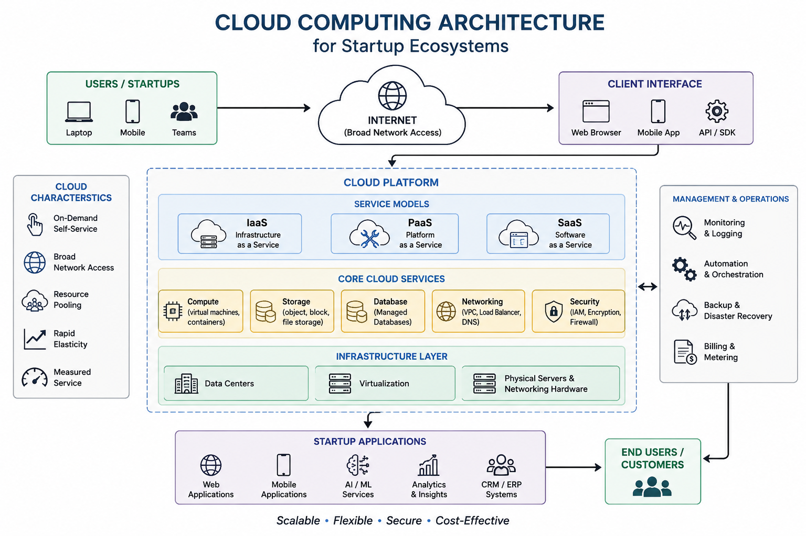

Architecture Diagram

Slide 10
Benefits for Startup Ecosystems
Major Benefits:
Reduced infrastructure costs.
Easy scalability for growing businesses.
Faster product development.
Improved collaboration among teams.
Enhanced data security and backup.
Global accessibility.
Automatic updates and maintenance.
Better business agility.

Slide 11
Real-World Use Cases
Cloud Computing in Startups:
E-Commerce Startups
Online product hosting.
Payment processing.
EdTech Startups
Cloud-based learning platforms.
Student data management.
FinTech Startups:
Secure transaction processing.
Real-time analytics.
Healthcare Startups:
Electronic health records.
Cloud-based appointment systems.

Slide 12
Impact on Startup Growth
Cloud Computing Enables:
Faster market entry.
Lower operational expenses.
Innovation through AI and analytics.
Better customer experiences.
Flexible resource management.
Startup Advantages:
Pay-as-you-use model.
No need for expensive hardware.
Supports remote and global operations.

Slide 13
Conclusion and Key Takeaway
Conclusion:
Cloud computing has become an essential technology for modern startups.
Its characteristics provide flexibility, scalability, and cost efficiency.
Cloud services help startups innovate and grow rapidly.
Key Takeaway:
Cloud Computing empowers startups by providing affordable, scalable, and reliable technological solutions that accelerate business success.

Slide 14
Thank You

Slide 15
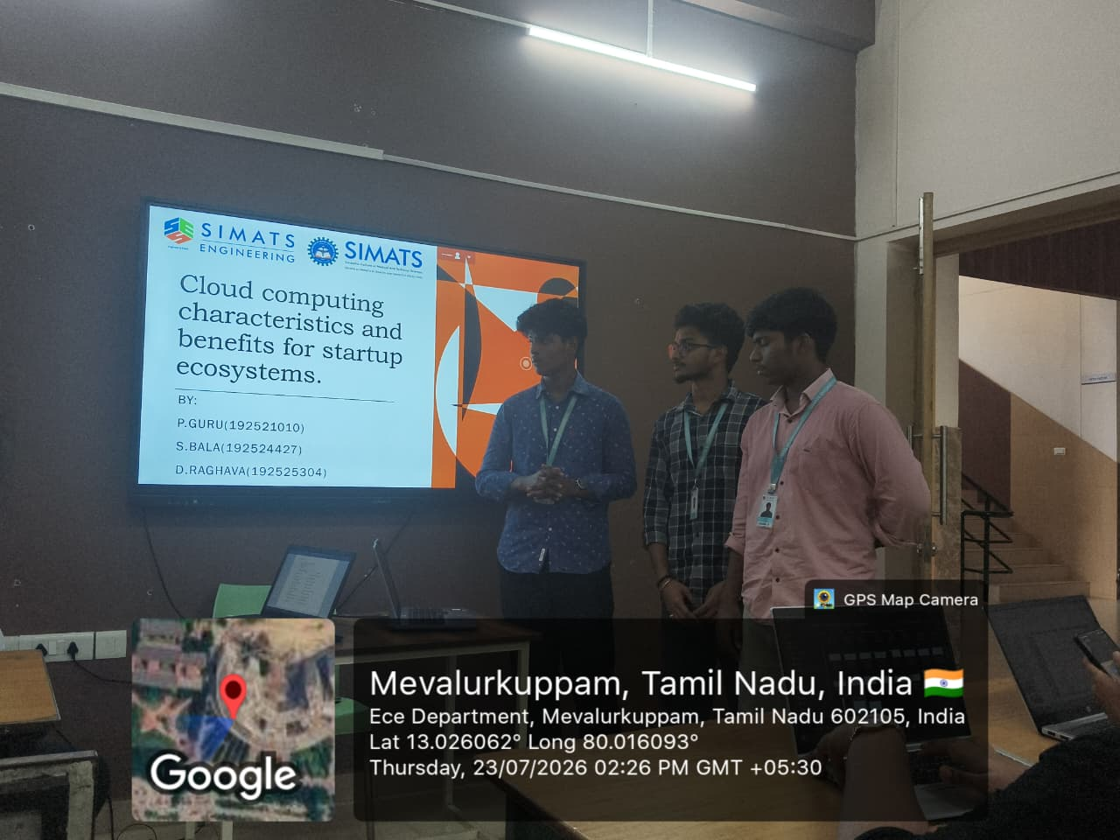

Slide 16
